Slide 1

Incident Analysis
Rooting Out the Cause

Slide 2
Incident Analysis
An incident analysis is a structured process conducted after an unexpected event or "incident" has occured. The purpose is to examine what happened, why it happened, and how the response can be improved in the future. By documenting and discussing the incident in a blame-free environment, an organization can learn from its mistakes and reduce the likelihood of future recurrences.

Slide 3
?
Why the Change in Terminology
Investigation = May infer a criminal action was committed to some
Review = What happened and why in general
Analysis = Deep dive into what happen, why it happened and how to address causation

Slide 4
Analysis vs Review
Smaller, relevant personnel gather the detailed facts and determine what, if any, action is needed and how to proceed
Safety committee receives report on an incident to offer further solutions or see if there is shared exposures
Notes:
The best programs(regardless of size) are doing the analysis at a high level. Programs that are stuck in neutral or reverse are doing the very basic review
They don’t see value in spending time in the process or are afraid that they’ll create more work or have to take action they don’t want to deal with.
Safety committee doesn’t do the analysis but reviews the results- don’t skip over detailed discussion
Make it more than a priority-It is a workplace value.

Slide 5


The 5 W’s
WHEN
Establishes the
timing of the incident
WHERE
WHAT
Specifies the location
of the incident
Describes the actions or
events that occurred
WHY
WHO
Explores the causes and
contributing factors
This should be further
dissected into layers
Identifies the individuals
involved in the incident
Incident Analysis
Notes:
Example of why- Library employee was walking to a car, while carrying a package and slipped on an ice patch. Employee had regular soled shoes on and was in a hurry.
Why did employee fall? - slipped on ice patch
Why wasn’t ice cleared? not on city property
Why didn’t employee avoid ice? was carrying package that obscured view
Why was employee carrying a package? Could we provide carts or why wasn’t cart used?
Why wasn’t employee wearing shoes appropriate for weather? Didn’t have time to put them on
Why was employee in a hurry? Late for a meeting

Slide 6

Company Nurse Reports
They are indicators that an incident has occurred
Some information can be used as part of the analysis
The information is typically from the perspective of the employee
These reports are not incident analysis
Using Company Nurse reports in lieu of an Incident Analysis Report could be a HIPAA and Privacy violation
Notes:
These reports are not substitutes for analysis as they provide only part of the bigger picture.

Slide 7
Who Should Lead the Analysis?
Safety Coordinator
Employee’s Supervisor
Department Head
Notes:
May need to hire consultant for some specialized issues to assist person leading the analysis

Slide 8
Terms
Incident
General term used to describe that something happened, but we don’t know if it was preventable or not.
Unplanned event that may have caused injury or property damage.
Notes:
Accidents - National Safety Council study found 10% of incidents are true accidents

Slide 9
Terms
An event that occurred that was not preventable because of unforeseen circumstances outside of our control
10% of events
Incident
Accident
Unplanned event that may have caused injury or property damage.
Similar to incident but could not have been prevented.
Notes:
Accidents - National Safety Council study found 10% of incidents are true accidents

Slide 10
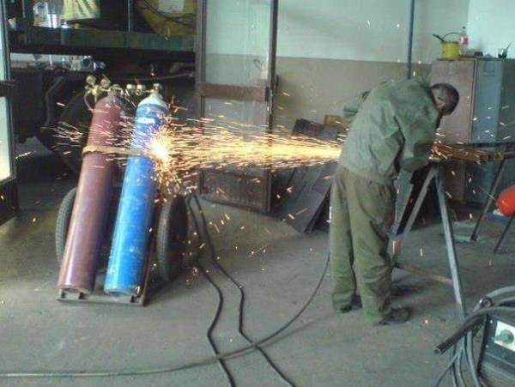
Terms
Incident
Accident
Unsafe Act
Unplanned event that may have caused injury or property damage.
Similar to incident but could not have been prevented.
An act that is performed any time an employee fails to abide by safety rules and protocols.
Notes:
Accidents - National Safety Council study found 10% of incidents are true accidents

Slide 11
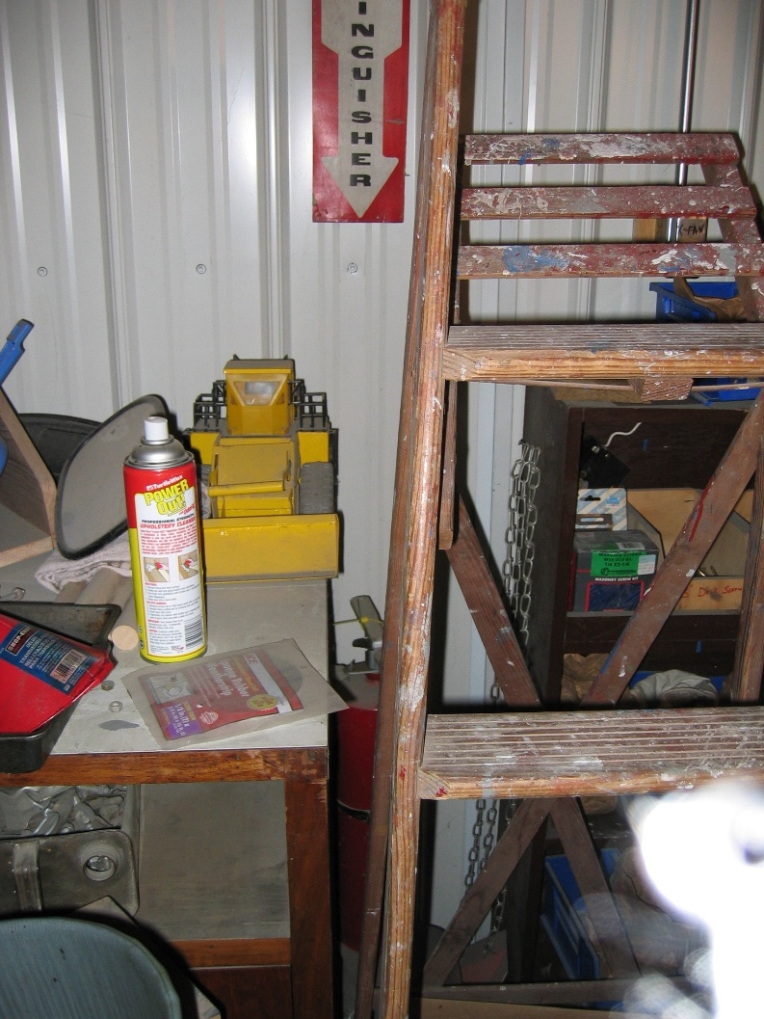
Terms
Unsafe Condition
Accident
Unsafe Act
Similar to incident but could not have been prevented.
An act that is performed any time an employee fails to abide by safety rules and protocols.
A condition in which hazards exist that have the potential to cause injury or death to an employee.
Can be created by an unsafe act.
Notes:
Accidents - National Safety Council study found 10% of incidents are true accidents

Slide 12
Terms Review
Unsafe Condition
Incident
Accident
Unsafe Act
Unplanned event that may have caused injury or property damage.
Similar to incident but could not have been prevented.
An act that is performed any time an employee fails to abide by safety rules and protocols.
A condition in which hazards that have the potential to cause injury or death to an employee.
Notes:
Accidents - National Safety Council study found 10% of incidents are true accidents

Slide 13
Before
the
Incident
Create an Incident
Reporting
Policy/Procedure
Train Employees on
Incident Reporting
Use a
Standardized Form
Notes:
Model policy on our website on safety manual- train employees and supervisors and hold them accountable to report on time! The longer an incident goes unreported the longer a safety hazard will exist
Model of IA form on IMWCA website- train supervisors and hold them accountable to fill out ( safety coordinator may be involved)
Completed forms should go to department head for review and approval and then sent to safety committee, council or board (for smaller members)

Slide 14
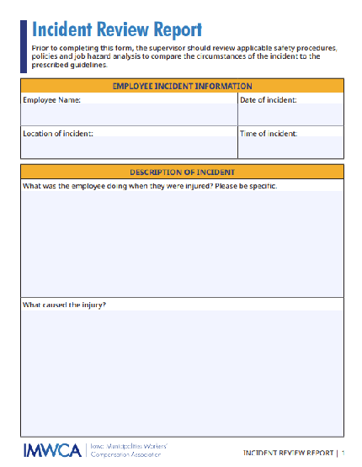
Incident
Fo
Incident Form
Notes:
Make a customized report form at ESRI Co. with package of ARC GIS. Survey 123

Slide 15







Analyze Any Claim With:
Fatalities
Amputations
Fractures
Burns greater than 2nd degree
Emergency medical care
Lost work time
Two or more employees injured at same incident
Notes:
OSHA requirements to report
See IMWCA reporting cards
Reporting to OSHA and responding with a good Incident Analysis can help you avoid an inspection and fines

Slide 16
Incidents Include:
Injuries (even minor injuries)
Potential for injury but no injury (near miss situation)
Property damage
When to
Take Action?
ASAP AFTER THE INCIDENT
Notes:
Small but frequent incidents can disclose bigger issues

Slide 17

Gathering Relevant Facts?
Interviews
Physical Evidence
Background Information
Notes:
Three sources of information
Make sure we focus on facts relative to the incident- have witnessed committees waste time discussing topics unrelated to the incident
Change camera icon!

Slide 18

Interviews
Ask open-ended questions: Who, What, When, Where, Why, How
Not an interrogation
Be empathetic towards the employees
Notes:
Interview witnesses separately to avoid groupthink-if possible have them write out their initial statement of what happened.
Ask them for their ideas how this could be avoided
Thank witnesses for their cooperation
Be aware that some people may need more time to process what happened based on their experience

Slide 19




Physical Evidence
Secure Area
When
Needed
Impound Broken Equipment
Take
Pictures
Hire Consultants
Notes:
Once injured is removed, try to maintain site. Address any major safety exposures-electrical or gas exposures
Broken equipment should be immediately impounded to check for failure or design flaws ( Subrogation)
Take a lot of pictures using different angles, size perspective and relation to location

Slide 20
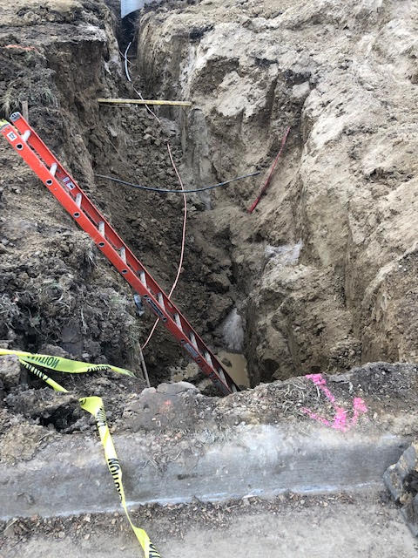
Trench Collapse
Notes:
example of limited picture
ladder gives some depth but lacks locational relationship to streets, spoil pile or any fencing.

Slide 21

Incident Description
Being very specific and detailed results in a better analysis
Notes:
Traffic fatality example why detail matters
Original report- employee struck by driver. Driver not cited.
When- October 16 at 4:00 pm
Where- right side of road, Highway # facing west
Who- Roads sign employee
What - Setting up sign truck to remove sign. struck by motorist heading west who claimed to be blinded by sun.
Why- No cones or signs were set. Not best practices to work with sun behind you!

Slide 22

To Name or Not to Name
Privacy
HIPAA
Notes:
Personnel conducting analysis have access to personal information related to claim in order to fully determine causation and trends. Some medical info can be pertinent to the causation.
Don’t need to mention names in the committee meeting
People may already know but proceed as if they don’t! Broken leg in a cast
BBP - not to create a stigma
No need to mention disciplinary actions- it's not relative to causation
Deep dive into the causation and not the injury
HIPAA- don’t mention any medical condition not related to causation of injury
diabetic example- medical condition contributed vs not a factor
example- committee only needs to know that person has a previous medical condition that contributed to claim and this issue is being addressed by their supervisor. They don’t need to know the condition.

Slide 23

Background
Injury History of the Individual
Employee Training Records
Previous Claims Involving the Same Procedure or Location
Equipment Service Records
Notes:
Who ever is conducting analysis does need to review employee history-
If injured party has multiple claims doing same task, we recommend Personal Safety Action Plan with supervisor, HR or department head. May be a sign of other issues Ie. medical or fitness related to claims.
Repeaters are a big challenge because no one has monitored these.

Slide 24
Why Do Incidents Occur?
Worker
Tools
Failure
Procedures
Training
Notes:
Too often we start with employee as the problem, which is why the process may fail
Procedures are outdated, incomplete or non-existent- LO/TO on equipment no longer used
Tools,equipment or facilities are unavailable, improper for use or in disrepair
Training is outdated, incomplete or non-existent- Employee failed to comprehend
Worker- forced to not follow SOPs ( we don’t have time for that) or,
physiological causes like exhaustion, distractions and ill-fitted to job
Not following policies- not using a seatbelt ( never enforced by supervisor)
All are controllable by management !

Slide 25
Identify Unsafe Conditions and Acts
Fatigue-related
Distractions
Impaired
Weather and terrain
Rushed
Notes:
Gather Facts to identify Unsafe conditions or acts-
Fatigue- long hours, other jobs
Distracted- cell phone
Weather and terrain ( can’t always control these but I can control how I interact with them)
Impaired- prescription and illicit drugs
Rushed - in a hurry and don’t follow safety procedures

Slide 26

A man falls off
an unstable step
ladder with a
damaged rung
Unsafe Act:
Climbing a defective ladder
Unsafe Condition:
A defective ladder
The Correction:
Get rid of the defective ladder and re-train on inspection and use

Slide 27




Root Causes and Barriers
Factors Contributing to Those Unsafe Situations
Unsafe Behaviors and/or Conditions
Identify
Positives
Notes:
Why do unsafe conditions or acts exist in your workplace? The different layers of “why”
Using the ladder example, why was a broken ladder being used?
Didn’t know it was broke- lack of inspection policy or someone put it back already broken
No budget to buy new one
We can still use that!
Unsafe act- why did employee use the ladder?
no other ladder-why not stop the task?
didn’t know better- lack of training
Didn’t want to get another ladder- Lazy or rushed?

Slide 28

After the
Analysis
Establish what needs to be done to prevent it from occurring again
Implement corrective actions
Follow up with all involved
Present findings
Notes:
Be specific :
Train employees on ladder use and inspection
Inspect all ladders for defects,
remove all defective ladders from service and destroy ( don’t leave on your property or let employees take home unless you like liability)
Develop written plan of action with a timeline to address each point. These can be monitored in safety committee meetings until resolves. OSHA may make a decision to visit if this isn’t included
Consider alternative plans if initial solutions don’t work.

Slide 29

Quiz Time

Slide 30

Slip and fall claim
Early December
Courthouse
No witnesses
Snow already removed
No tread on footwear
Member of public fell earlier
Notes:
Was employee distracted
Was footwear only issue?

Slide 31



Slide 32
All claims occurred 1:00 to 4:00
Incidents occured on SE corner of Courthouse
More
Facts
No one rechecked sidewalks
6 other incidents at same site
Salt and sand provided but not used
Notes:
Went to location at the afternoon and looked for what was unique.
Spotted leaking gutter landing on sidewalk
Roof was exposed to sun and caused runoff into leaking gutter
The area on sidewalk was partially shaded and therefore cooler causing ice to refreeze
No sand used because they assumed the sidewalk were clear after snow removed

Slide 33
Questions

Slide 34
safetyandrisk@iowaleague.org
HAVE A SAFE DAY.

